Slide 1

Medical Diagnosis
- Aryan Bharadwaj
Graph Neural Network Seminar

Slide 2
Objectives
Diagnosis
The Brain
About the project
Results

Slide 3
The Massive Global Burden
74%
>3B
Global Deaths
Neurological Cases
attributed to non-communicable
chronic diseases
of people currently living with a
neurological condition worldwide.
Notes:
https://www.who.int/news/item/14-03-2024-over-1-in-3-people-affected-by-neurological-conditions--the-leading-cause-of-illness-and-disability-worldwide

Slide 4
Brain Diagnosis
Definition: is the clinical process of identifying and evaluating pathological conditions affecting the central nervous system using automated computational tools, statistical models, and neuroimaging data.
Reduces Global Mortality: Brain disorders account for a massive, continuously growing percentage of global deaths, by early detection
Manages Complex Pathologies: Helps navigate complex, newly discovered variants of progressive neurological diseases.
Improves Clinical Accuracy: Precision analysis reduces diagnostic human errors across highly subtle brain changes.
Enhances Patient Betterment: Finding precise detection techniques directly elevates long-term healthcare outcomes and recovery.
Notes:
P. Khan et al., "Machine Learning and Deep Learning Approaches for Brain Disease Diagnosis: Principles and Recent Advances," in IEEE Access, vol. 9, pp. 37622-37655, 2021, doi: 10.1109/ACCESS.2021.3062484.

Slide 5
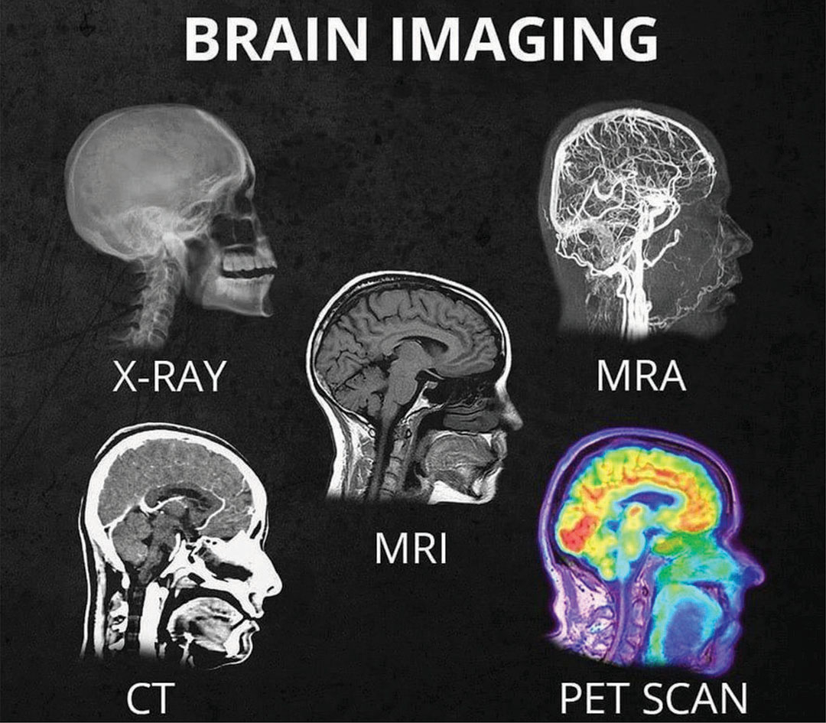
Types of Scans
Medical scans are diagnostic tools used to visualize the inside of the body. The four primary types:
X-ray
CT Scan
MRI
Ultrasound
PET
NIR
Notes:
https://sdbif.org/whats-the-difference-between-all-the-different-head-scans/

Slide 6
Types of Data
Structural High-Resolution Images (sMRI): 3D spatial tissue volumes mapping anatomical integrity, cortical thickness, and structural atrophy.
Functional Signal Time-Series(fMRI): 4D blood-oxygenation (BOLD) or electrical potential fluctuations tracking active neural communication over time.
Diffusion & Tractography Data (DTI/dMRI): Microstructural water diffusion trajectories tracing white matter physical wiring and axonal fiber bundles.
Multimodal Tabular Clinical Data (EEG): Combined phenotypic metrics, demographic profiles, cognitive battery test scores, and patient medical histories.
Notes:
https://sdbif.org/whats-the-difference-between-all-the-different-head-scans/

Slide 7
Why do we analyze?
Sociodemographic & Behavioral Data: General background variables including age, sex, socioeconomic markers, and critical health behaviors (e.g., sleep patterns, diet, and lifestyle habits).
Clinical Medical History: Comprehensive records tracking personal medical histories, physical health examinations, and specific disease-related symptoms.
Cognitive & Psychological Assessments: Standardized neurocognitive test scores alongside tracking scales for depression, behavioral changes, psychological updates, and caregiver burden.
Biomarkers & Lab Diagnostics: Laboratory results gathered from direct physical processing, including comprehensive blood panels and sensory assessment data (such as olfactory performance tests).
Notes:
https://sdbif.org/whats-the-difference-between-all-the-different-head-scans/

Slide 8
Why Machine Learning?
Processes Massive Dimensions: Computes millions of complex neuroimaging voxels simultaneously, surpassing human capability.
Detects Hidden Patterns: Identifies subtle, non-linear structural variations years before physical symptoms appear, allowing faster, life-saving therapeutic interventions.
Eliminates Human Subjectivity: Provides objective, automated diagnostic recommendations to eliminate fatigue and clinical bias.
Tracks Interconnected Dynamics: Maps complex, widespread network disruptions rather than isolated regional damage.
Notes:
P. Khan et al., "Machine Learning and Deep Learning Approaches for Brain Disease Diagnosis: Principles and Recent Advances," in IEEE Access, vol. 9, pp. 37622-37655, 2021, doi: 10.1109/ACCESS.2021.3062484.

Slide 9
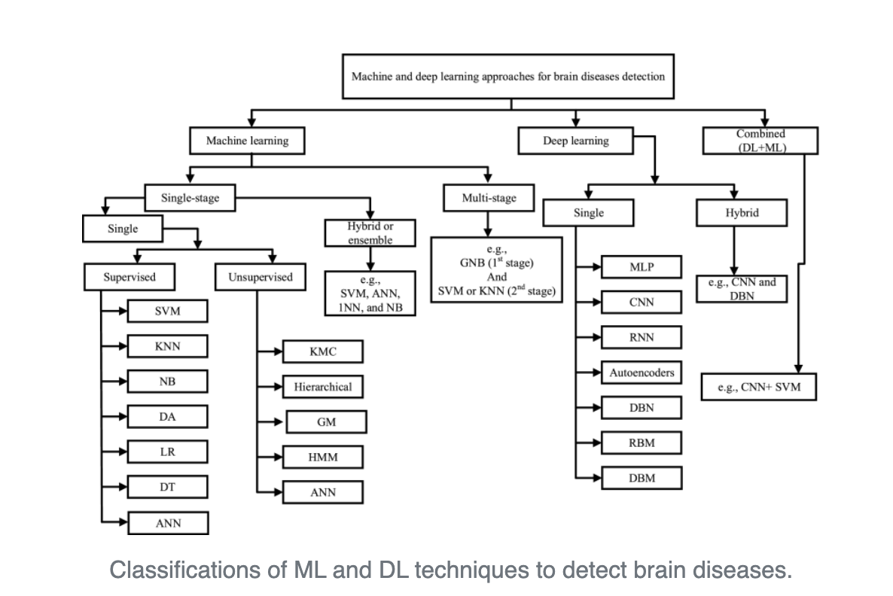
Brain Diagnosis
Notes:
P. Khan et al., "Machine Learning and Deep Learning Approaches for Brain Disease Diagnosis: Principles and Recent Advances," in IEEE Access, vol. 9, pp. 37622-37655, 2021, doi: 10.1109/ACCESS.2021.3062484.

Slide 10
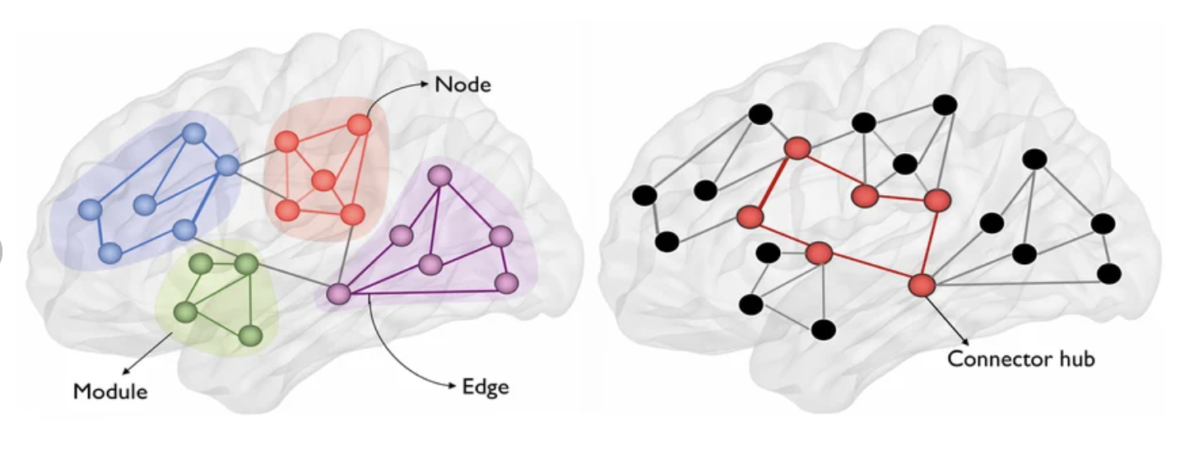
The Brain: A Global Communication Hub
The Networked Organ
The brain functions through thousands of interconnected nodes working in concert.
Edges(E): Structural and functional pathways.
Nodes(V): Anatomical regions.
Node Feature Vectors (X): Local ROI attributes
Connectome: The complete map of neural links.
Module: A highly interconnected cluster of brain regions that group together to perform specialized neural functions.
Connector Hub: A high-traffic network node that links different modules together, coordinating global information flow across the brain.
Notes:
https://www.researchgate.net/figure/Illustration-of-graph-theoretic-measures-In-the-context-of-brain-networks-in-this-study_fig1_353482746

Slide 11
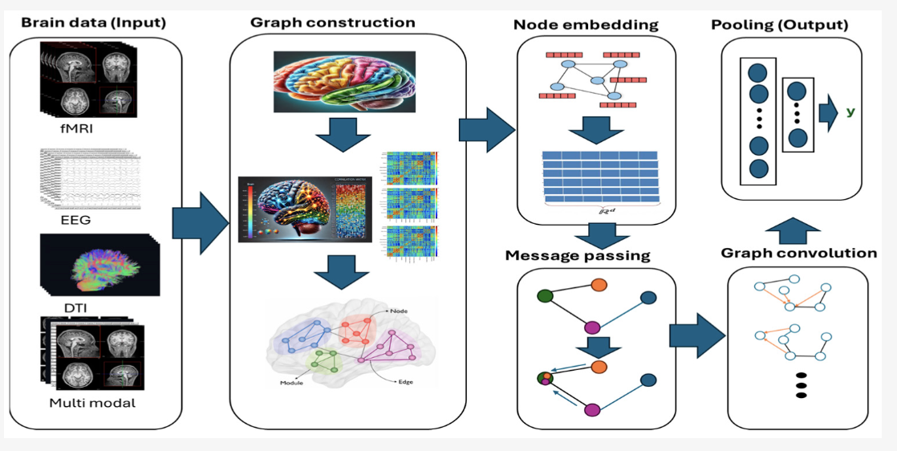
Graph construction
Notes:
https://www.researchgate.net/figure/Illustration-of-graph-theoretic-measures-In-the-context-of-brain-networks-in-this-study_fig1_353482746

Slide 12

Graph construction
Multi-Modal Data Ingestion: Accepts diverse raw brain scan modalities including fMRI (functional), EEG (electrical), DTI (structural wiring), or multi-modal combinations.
Parcellation & Node Definition: Maps 3D brain regions or sensor sites as graph nodes (V).
Connectivity Matrix Generation: Computes inter-regional correlation or structural strength matrices to establish edges (E) and modular networks.Node
Feature Matrix Construction: Extracts feature vectors for each region to generate a high-dimensional node embedding matrix
$$X∈R^{N∗d}$$
Notes:
https://www.researchgate.net/figure/Illustration-of-graph-theoretic-measures-In-the-context-of-brain-networks-in-this-study_fig1_353482746

Slide 13






When the Brain Falters
Vascular (Stroke)
Tumors/Lesions
Neurodegeneration
Sudden Oxygen deprivation causing sudden immediate structural death in specific lobes
Physical mass effects displacing hralthy brain tissue and disrupting signaling
Slow, silent netowrk colapse. Typical of Alzheimer’s and Parkinson’s disease.
Notes:
https://medlineplus.gov/braindiseases.html

Slide 14
Paper 1
Name : Generalizing prediction of task-evoked brain activity across datasets and populations
Introduction & Motivation:
Evaluates deep learning frameworks applied to brain functional connectivity (FC) derived from fMRI scans.
Investigates whether Graph Neural Networks (GNNs) learn personalized topological patterns or rely on group-level statistical averages.
Formulated Prediction Tasks:
Classification: Predicting binary/multiclass clinical status (e.g., Alzheimer's Disease vs. Healthy Control).
Regression: Estimating continuous behavioral and cognitive phenotypes (e.g., fluid intelligence score, chronological age).
Notes:
https://www.researchgate.net/figure/Illustration-of-graph-theoretic-measures-In-the-context-of-brain-networks-in-this-study_fig1_353482746

Slide 15
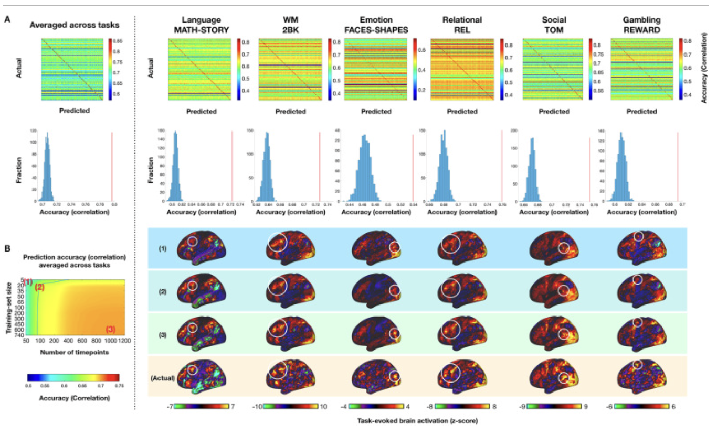
Graph construction
Main Results & Findings:
GNNs successfully capture non-linear, higher-order topological interactions across functional brain networks.
Models significantly outperform traditional kernel/linear baselines (e.g., SVMs) while confirming that individual-specific connectivity signatures are retained rather than lost to group-average noise.
Notes:
https://www.researchgate.net/figure/Illustration-of-graph-theoretic-measures-In-the-context-of-brain-networks-in-this-study_fig1_353482746

Slide 16
Paper 2
Name: Intelligent medical diagnosis model based on graph neural networks for medical images
Introduction & Problem Statement:
  Addresses the limitation of standard CNNs/ANNs that rely on regular grid-like inputs, whereas physiological brain data exhibits non-euclidean, irregular patterns.
  Proposes a GNN framework that models brain structures as interactive nodes connected by anatomical and temporal edges.
Methodology & Architecture:
  Graph Construction: Structural GNN designed to explicitly differentiate structural changes and disease impact across the left and right brain hemispheres.
  Multimodal Integration: Integrates underlying spatial imaging features with demographic clinical metadata.
  Multi-Task Formulation: Simultaneously performs Classification (detecting severity degrees) and Regression (estimating continuous disease indices).
Notes:
https://www.researchgate.net/figure/Illustration-of-graph-theoretic-measures-In-the-context-of-brain-networks-in-this-study_fig1_353482746

Slide 17
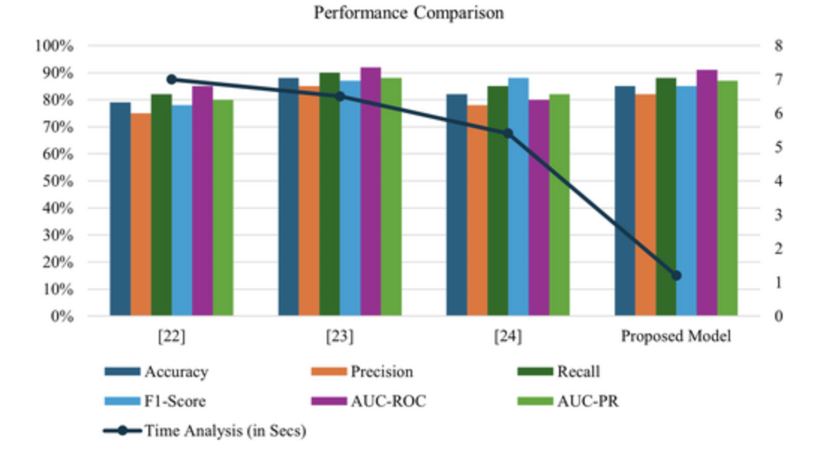
Paper 2
Experimental Dataset & Results:
Evaluated on a real dataset of 800 medical brain
image cases (560 moderate, 240 severe).
Classification Performance:Achieved a top 92.27%
AUC, outperforming baseline models.
Regression Performance:Achieved a
0.62 correlation coefficient(r), validating
strong predictive alignment for
continuous outputs.
Notes:
https://www.researchgate.net/figure/Illustration-of-graph-theoretic-measures-In-the-context-of-brain-networks-in-this-study_fig1_353482746

Slide 18
Summary
Neurological disorders affect over three billion people worldwide, creating a massive health burden.
Diagnostic data includes neuroimaging scans and clinical markers like cognitive assessments.
Brain networks model anatomical regions as nodes and structural or functional pathways as edges.
GNN pipelines process multimodal connectivity matrices to generate classification or regression outputs.
Research shows GNNs outperform SVMs by capturing non-linear topological brain interactions.
A featured GNN model achieved a 92.27% AUC for medical brain image classification.
Notes:
https://www.researchgate.net/figure/Illustration-of-graph-theoretic-measures-In-the-context-of-brain-networks-in-this-study_fig1_353482746

